Slide 1
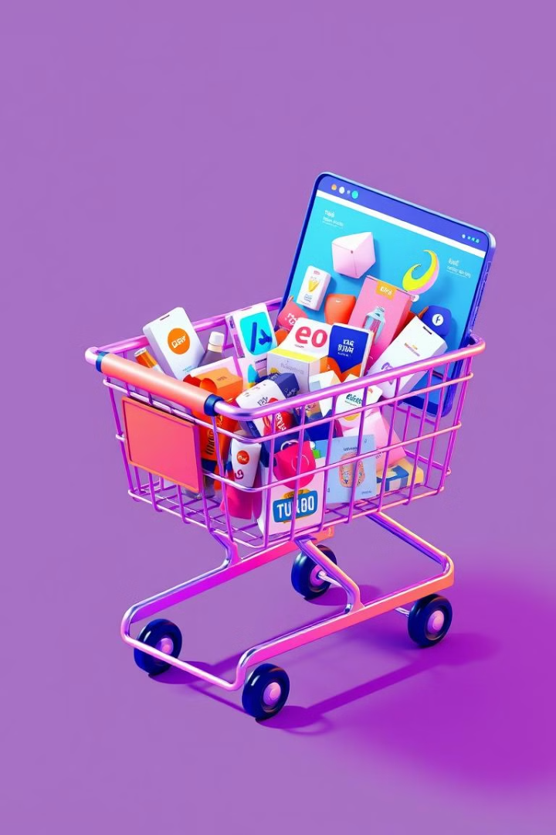
Online Shopping Cart with Software Design Patterns
This presentation explores the implementation of common software design patterns in an online shopping cart application. We'll examine the benefits of using design patterns to create a robust, maintainable, and scalable solution.
.

Slide 2
Introduction to Design Patterns
What are Design Patterns?
Benefits of Using Design Patterns
Design patterns are reusable solutions to common software design problems. They provide a blueprint for solving specific design challenges encountered in software development.
Design patterns promote code reusability, improve maintainability, enhance flexibility, and facilitate collaboration among developers.

Slide 3
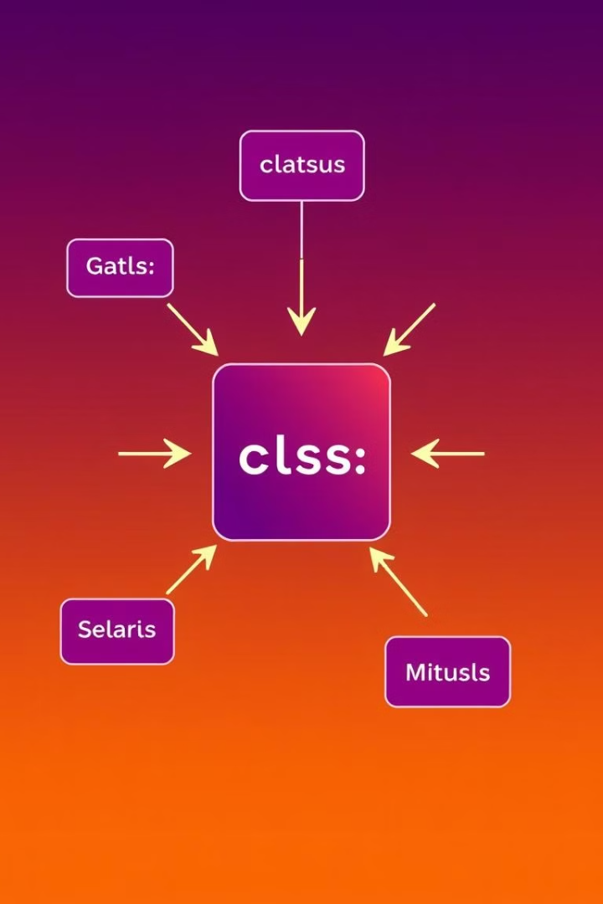
The Singleton Pattern
Purpose
Example
Ensures that a class has only one instance and provides a global point of access to it.
A database connection manager or a logging service.

Slide 4
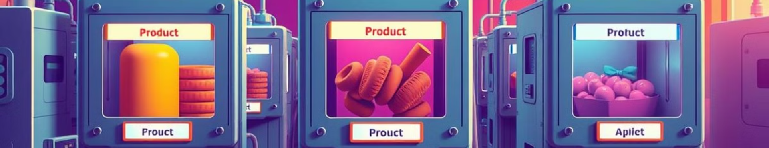
The Factory Pattern
1
Objective
2
Use Case
Defines an interface for creating objects, but lets subclasses decide which class to instantiate.
Creating different types of products in an online store, such as shirts, pants, or shoes.

Slide 5
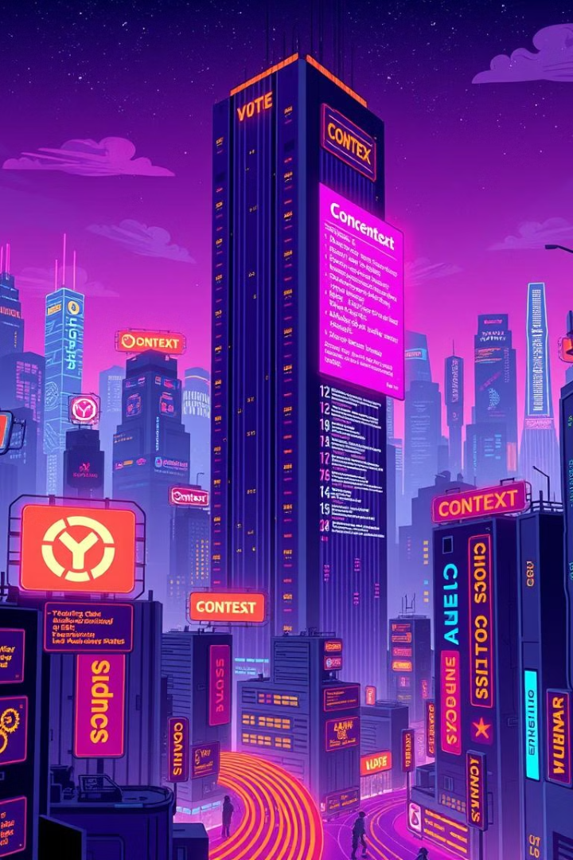


The Strategy Pattern
Flexibility
Variety of Options
Allows algorithms to be swapped at runtime, making the application adaptable to changing requirements.
Different strategies can be used for handling discounts, shipping calculations, or payment processing.

Slide 6
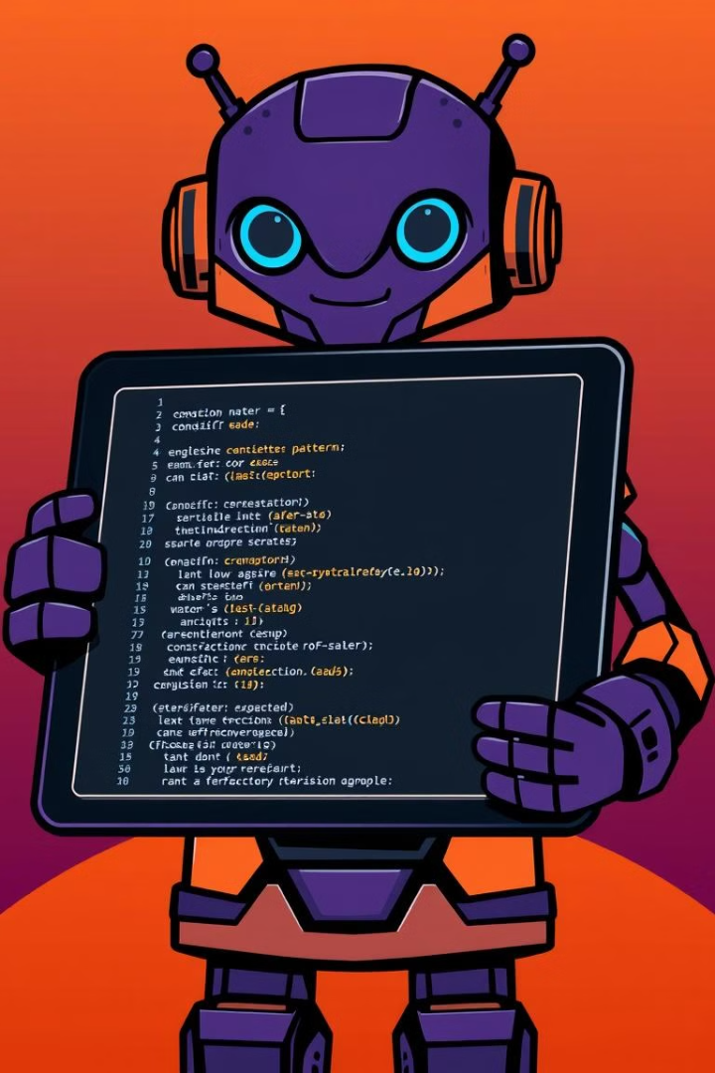
Implementing the Singleton Pattern in the Online Shopping Cart
1
Initialization
A private constructor prevents direct instantiation of the class.
2
Instance Management
A static instance variable holds the single instance of the class.
3
Access Method
A static getInstance() method provides controlled access to the single instance.

Slide 7




Implementing the Factory Pattern in the Online Shopping Cart
Product Interface
Defines common attributes and methods for all product types.
Concrete Product Classes
Implement the product interface for specific product types.
Factory Class
Provides methods to create instances of concrete product classes.

Slide 8



Implementing the Strategy Pattern in the Online Shopping Cart
1
Strategy Interface
Concrete Strategies
2
Implement discount calculation algorithms.
Context Class
3
Holds a reference to the chosen strategy.

Slide 9
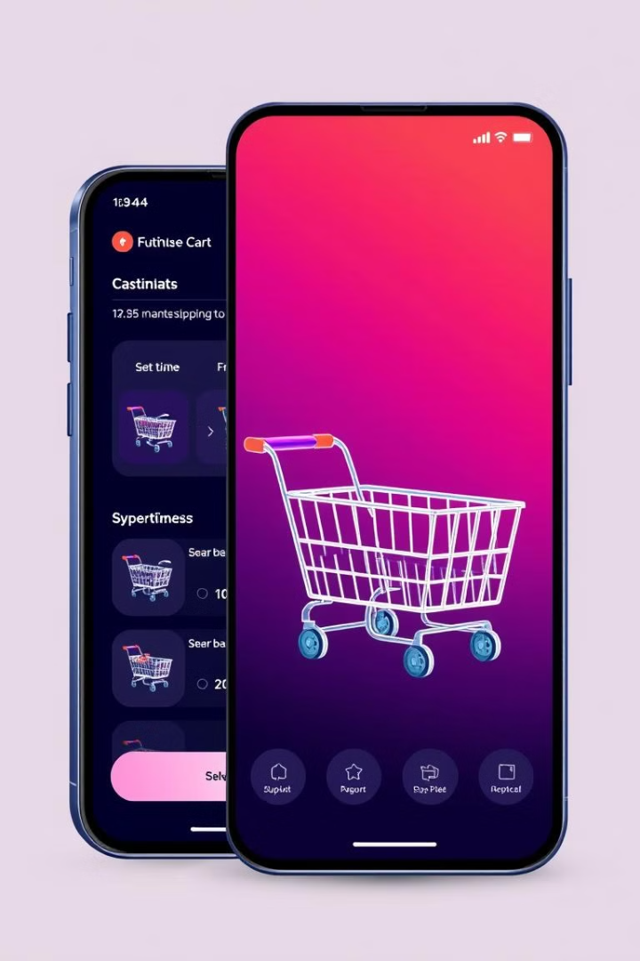
Conclusion and Key Takeaways
1
2
Maintainability
Flexibility
Design patterns make code easier to modify and extend.
They allow the application to adapt to changing requirements.
3
Reusability
Code can be reused in different parts of the application or in other projects.

